Slide 1

Overview of IT infrastructure and transfer of SIS webpage

Slide 2
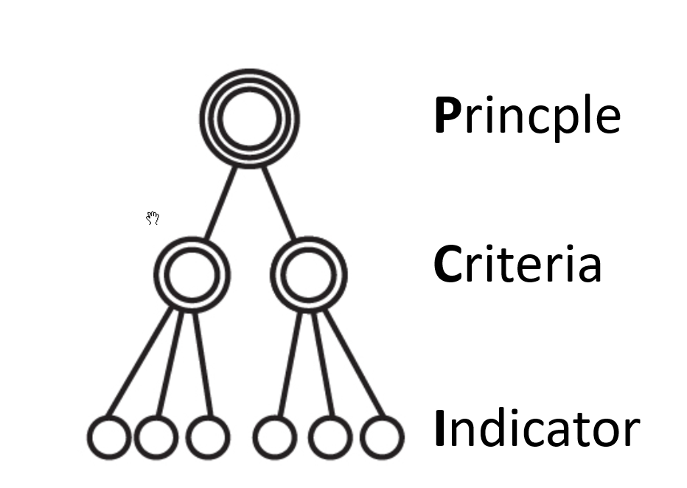
What make a good platform for SIS
Suitable with current/ operational system of the host organization
Preferably developed on free and open source software
Many part of SIS content is text-based so a CMS is a good options.
Support multi-level structure of principle, criteria, indicators
Support integration with 3rd party maps and reporting system
Support role-based management and workflow

Slide 3

SIS components
SIS Website/ Web platform
SIS REDD+ database
System Admin
Collect, compile and manage data on REDD+ safeguard
Interface/ Template
Editors
Reviewers
Documents
3rd party database
REDD agency/
Data provider

Slide 4

Information from other Ministry
MARD
National Steering Committee on Sustainable forest development 2016-2020 and REDD+ implementation
REDD agencies
VNFOREST
CPMU
REDD+ projects
Responsible for SIS management
Vietnam REDD SIS management

Slide 5
Web platform options
Content management system (CMS)
WebPortal
Custom build

Slide 6
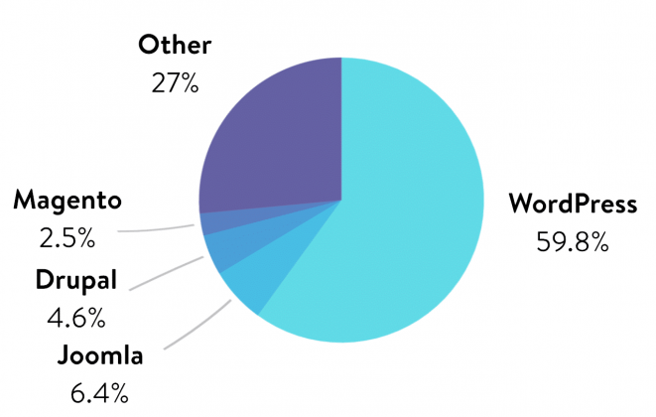




Web platform options
CMS: WordPress, Drupal (PHP), Dijango (Python)
  WordPress: easy to implement
  Drupal, Django: flexibility, extendability
  Localized CMS: localization
Head-less CMS: Strapi, Ghost
  Integration, strong user management
  Easy to build API
  Closer to the database
  Have to build new front end
WebPortal: Liferay, SAP, Oracle, IBM Websphere
  Powerful, extensible, security
  Java based

Slide 7
Consideration
 | WordPress | Drupal | Django | Headless CMS | Portal
Software cost | free | free | free | free | Free to very expensive
Development cost | Low | Higher | Higher + | Higher | depend
Extensibility | 1 | 3 | 3 | 3 | 3
Security | - | + | + | + | ++
Infrastructure requirement | 1 | 2 | 2 | 2 | 3
Interface | Out of the box | Highly customized | Highly customized | Have to be build | Highly customized, Drag&Drop + codding
User management | One level | Role-based user management | Role-based user management | Role-based user management | Role-based user management*

Slide 8

Solution selection
Web portal: Liferay portal
Free and open source
Highly customizable
Build in function for library management including full text search
Strong user management options.

Slide 9
SIS hosting
SIS v1.0 was hosted on FORMIS server. The address was https://sis.vietnam-redd.org.
Since the Vietnam REDD website was no longer functioned (end of UN REDD project) the SIS was also stop working.
The restored SIS v1.0 now hosted on FPD server. The new address are https://sis.kiemlam.org.vn/
Server: 2 CPU, 16 G RAM, 1 T storage, Window server

Slide 10
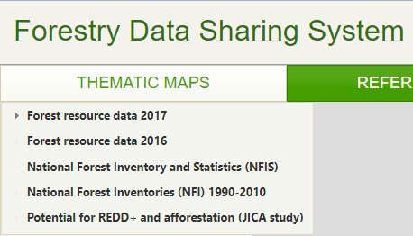
FORMIS
Map from datasharing can be embedded to SIS, but data was updated to 2017 only.
Forest data from FRMS can be used on SIS as aggregated data table
FRMS database
Data sharing
FRMS application
FORMIS server
FPD server
Review
SIS 1.0
SIS 1.0
https://sis.vietnam-redd.org
https://sis.kiemlam.org.vn/

Slide 11
How SIS indicator are organized in the portal
Use Hierarchical much like a table of content in Word file.
Safeguard (L1)
  Element (L2)
    Question (L3)
      Parameter (L4)
Use tag to classify content as Address/Respect

Slide 12
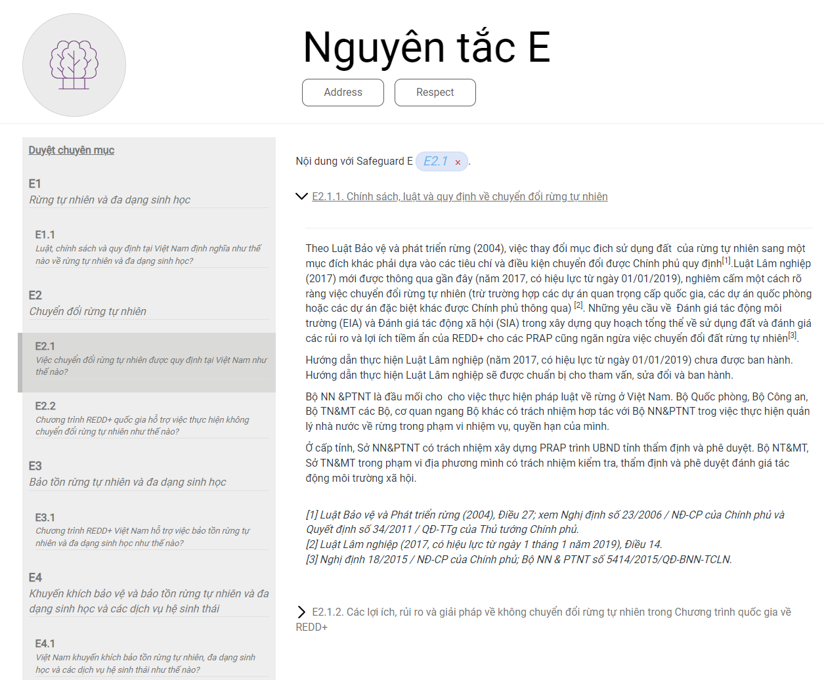
Level 1 - Safeguard
tag
Level 4 - parameters
Level 2 Element
Level 3 -Question
Level 4 - parameters

Slide 13
Type of content
Static page content: introduction, about, description
Parameter content
Follow the Hierarchical an numbering convention to keep the parameter well organized. Use tag for Address/Respect
Text (rich text)
Image
Table
hyper link
foot note
Html
Dynamic content (portlets)
Library
Folder structure
Document (word, pdf)
Image
Video
Full text search (include file content)

Slide 14
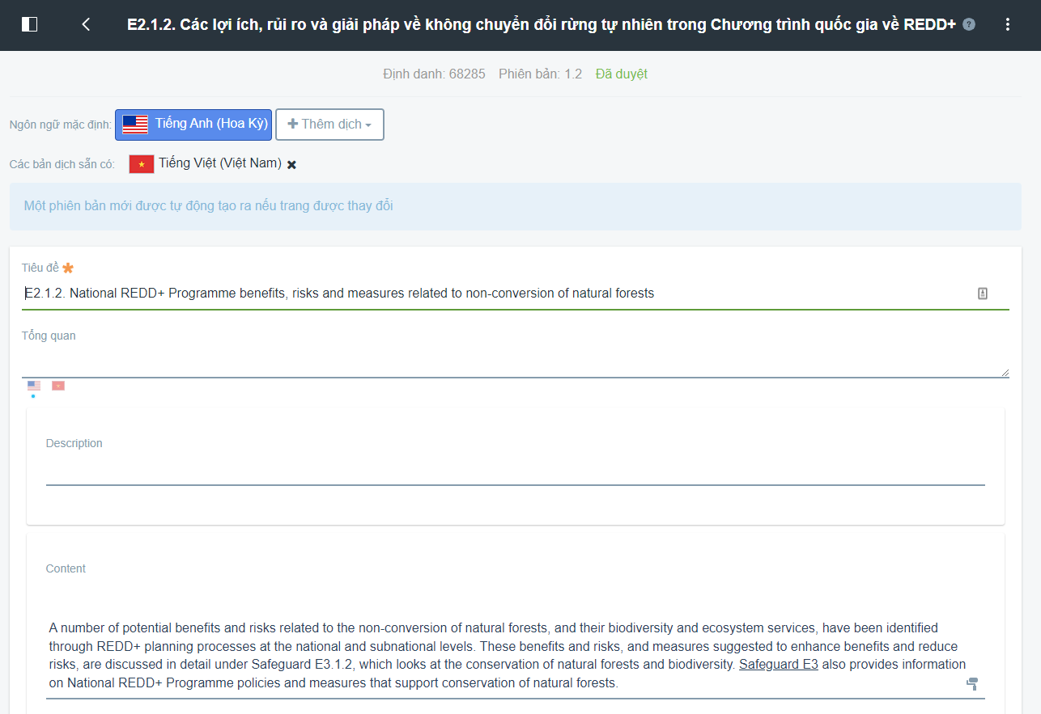
Support multiple language
Content translation must be enter by human

Slide 15
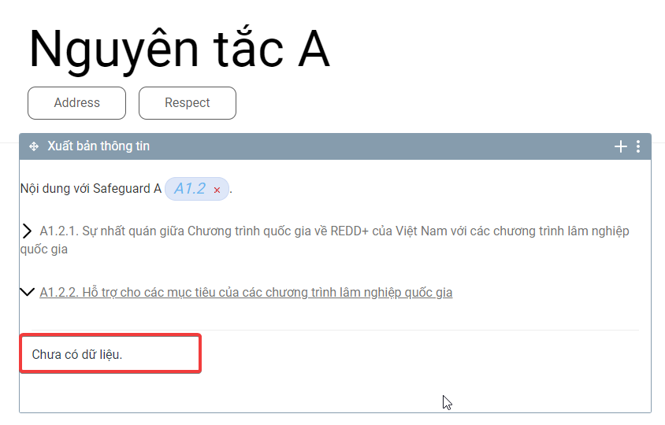
System maintenance and operation
FPD content managers
Ad-hoc update of the content if required (spelling mistake, data mistake, update hyper link)
Annual/bi-annual update of selected parameters (forest cover, area of natural forest)
  Data from MARD: FPD, other departments
  Data from other Ministry: e.g. GSO, MoJ
Update for parameters that currently do not have content
Other department MARD or other Ministry
Provide data through FPD
Tech support
Server maintenance (install patch, update)
Back up and restoration
Extend storage if required

